Slide 1
BOMB SQUAD
ARC’s Pre ATMOS 2017 Workshop

Slide 2
Plan Of Action
Basic Motor Connections
Bluetooth Connections with Phone
Pairing Bluetooth with Phone
Controlling Robot with Phone
Notes:
yay

Slide 3
Warm Up

Slide 4
Motor Connections
Two Motors x Two Terminals = 4 Wires
ESP12E has dedicated GPIOs for communication, reserve them. We’ll need those pins later.
The mathematics involved above is too hard.

Slide 5
WHAT IS ESP?
ESP is a franchise, just like Arduino.
Different microcontrollers from the ESP franchise are available for use (ESP8266, ESP-01, ESP-12, ESP12-E, ESP-F, ESP-32, etc.) just like different microcontrollers are available from the Arduino franchise (Arduino Uno, Arduino Nano, Arduino Mega, Arduino LilyPad, etc.)
A specific set of hardware for the microcontroller, aliased ESP8266 hardware.
Once the Arduino IDE is setup with the required ‘stuff’ (stuff that makes the IDE understand what the hell is being programmed), the microcontroller can be programmed in Arduino’s default language.

Slide 6
NodeMCU 1.0
A development board for ESP12-E
DevBoard eliminates need of making connections that will be essential in every project (Power Supply, Serial Connections, Reset/Flash buttons, etc.)
NodeMCU 1.0 is an ingenious design in terms of pin-placement, and compared to NodeMCU 0.9
Along with the Arduino IDE, it’s just like programming a more advanced Arduino board.

Slide 7
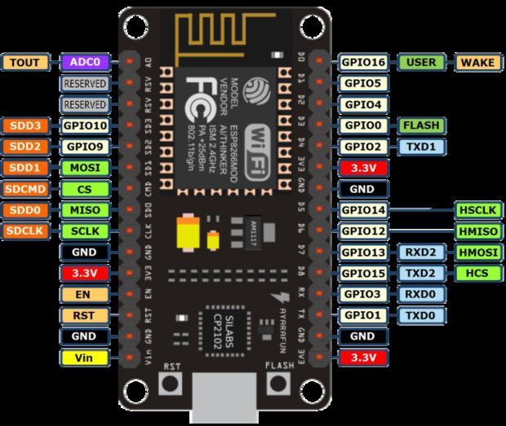

Slide 8
Repeat the Line Follower
Different Microcontroller ⇒ Different Pins
Input 1 ⇒ D1
Input 2 ⇒ D2
Input 3 ⇒ D8
Input 4 ⇒ D6

Slide 9
Bluetooth Module HC-05
The Bluetooth module HC-05 is a MASTER/SLAVE module.The Role of the module (Master or Slave) can be configured only by AT COMMANDS. The slave modules can not initiate a connection to another Bluetooth device, but can accept connections
Through AT Commands you can change the ROLE of the module. Name,Password of the Module can be changed.
The KEY pin is used to enter the Command mode. And change all of the above. When doing this the controller communicates by UART.(Universal Asynchronous Transmitter Receiver).

Slide 10
Bluetooth Connections
Tx ⇒ Rx (Tx if you are using AT commands)
Rx ⇒ Tx(Rx if you are using AT commands)
Vcc ⇒ 5v
GND ⇒ GND
Here we use it as a slave module which it is by default, and we interchange the pins of Rx and Tx.
Why?

Slide 11
Pairing with App.
Download Control Joystick from App Store.
Pair by entering Password “1234”.
And Connect to car ⇒ HC-05.
This uses the HC-05 as a slave and sends the data to the Rx pin of the controller which can then be read via Serial Communication.

Slide 12
MFRC522 Connections
MFRC522
Use the dedicated GPIOs pins we saved earlier.
SCLK ⇒ D5
MISO ⇒ D6
MOSI ⇒ D7
SDA ⇒ D4
RST ⇒ D3

Slide 13


Slide 14
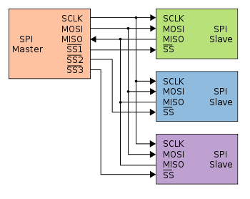
SPI : Serial Peripheral Interface
A protocol for communicating with multiple devices in an ordered way.
N devices require not 4N wires but only N+3 wires
SCLK: Serial Clock. Keeps everything(everything!) in sync.
MOSI: Master Out Slave In. Relays data that the master sends out and the slaves receive.
MISO: Master In Slave Out. Relays data that the slave sends out and master receives.
SS: Slave Select. Which slave to USE... Quite literally.

Slide 15
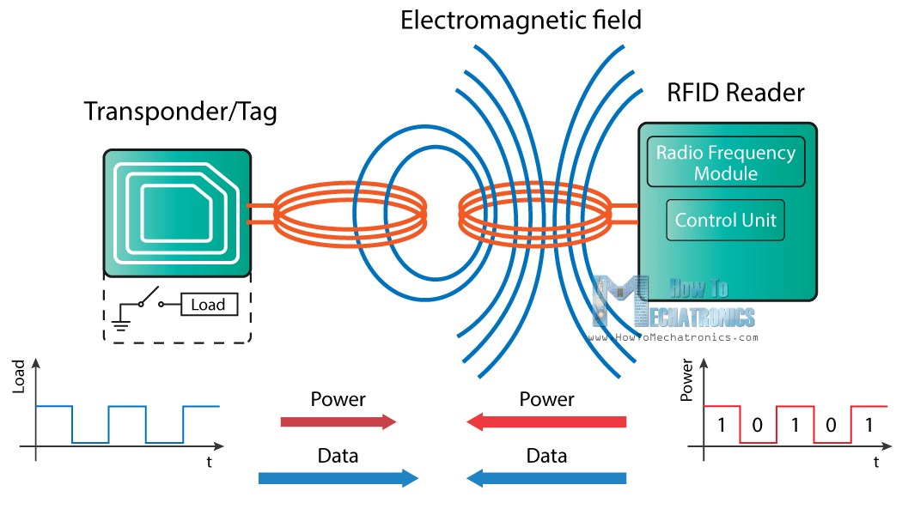
MFRC522

Slide 16
MFRC522
Tag waits for a signal from an RFID reader.
The reader sends energy to an antenna.
Antenna converts that energy into an RF wave.
The RFID tag’s internal antenna draws in energy from the RF waves.
The energy moves from the tag’s antenna to a charge pump, which powers the IC inside for a short time.
The IC generates a signal back to the RF system (backscatter).
This change in the electromagnetic or RF wave, is detected by the reader (via the antenna), which interprets the information.

Slide 17
MFRC522

Slide 18
Connections
Two Motors x Two Terminals = 4 Wires
ESP12E has dedicated GPIOs for communication, reserve them until absolutely necessary.
The mathematics involved above is too hard.
Bluetooth
These pins are the ones going out to your computer as well.
Do you know why Bluetooth was named so?
MFRC522
Use the dedicated GPIO pins we saved above.
This works on SPI. Read about SPI, I²C, One-Wire protocols.
What is the common serial connection (Rx, Tx) usually called?

Slide 19
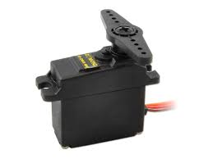
Servo For Gripper
Brown - GND
Red - 5V
Orange - D0

